Slide 1
Diamond Insights
Diamonds feature analysis.
By Nikhil K Raman

Slide 2
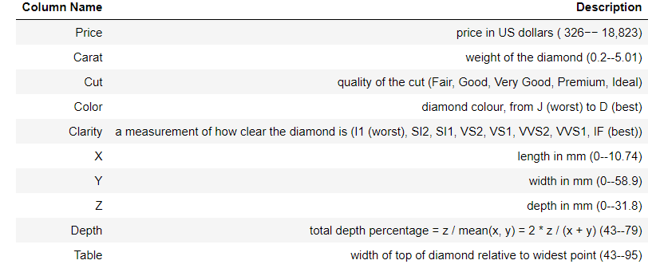
Dataset Information
This classic dataset contains the prices and other attributes of almost 54,000 diamonds.

Slide 3
Problem Statement
To understand how various features of a diamond effect its pricing and to draw conclusion as to which diamonds are affordable for the masses.

Slide 4
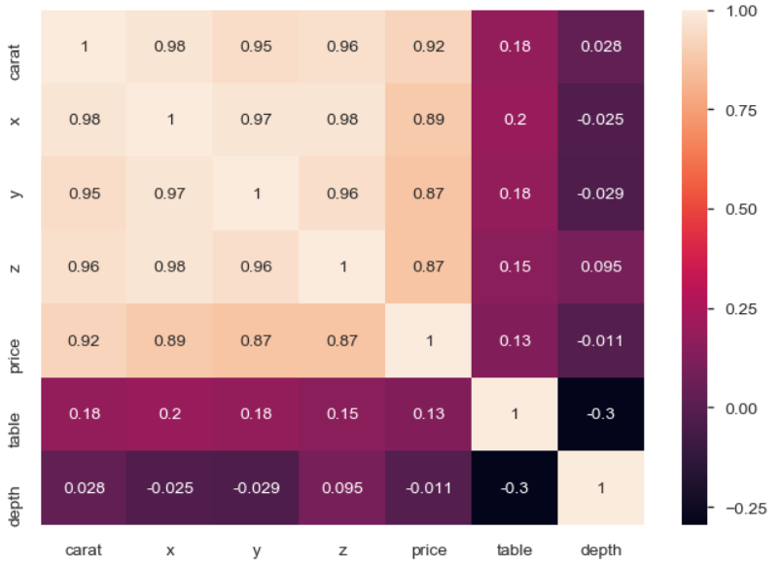
Profiling Results and pre-processing
The pre-profiling heatmap shows that the columns carat, x, y and z are highly correlated to price as well as each other.
During pre-processing more columns are derived to give numerical values to categorical columns cut, color and clarity. These values will be priorities based on the value in the parent column.
Another column will be derived which will combine all the categorical columns together

Slide 5
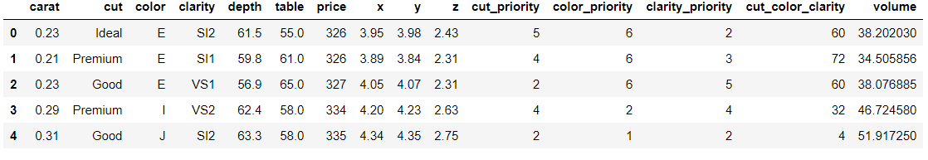
Data after pre-processing
As you can see the cut_color_clarity column is derived by multiplying columns cut_priority , color_priority and clarity_priority. Which in-turn were derived based on quality of the values present in the corresponding categorical columns.
Another column volumn is derived which is the result of x(length)*y(width)*z(depth) of a diamond.

Slide 6
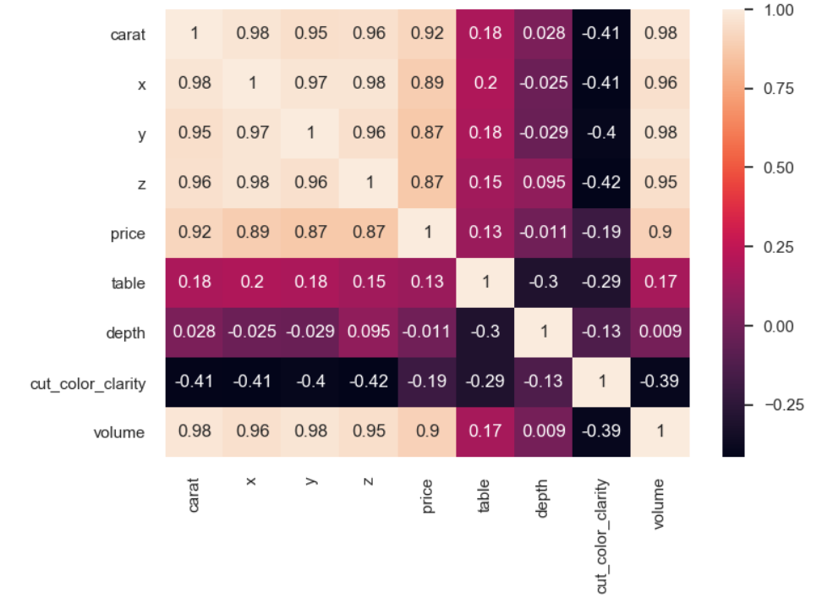
Post processing results.
Volume and carat are highly correlated so the conclusions drawn using carat will be the same as conclusions drawn using volume. Similarly the conclusions drawn for carat will be the same as conclusions drawn for volume

Slide 7
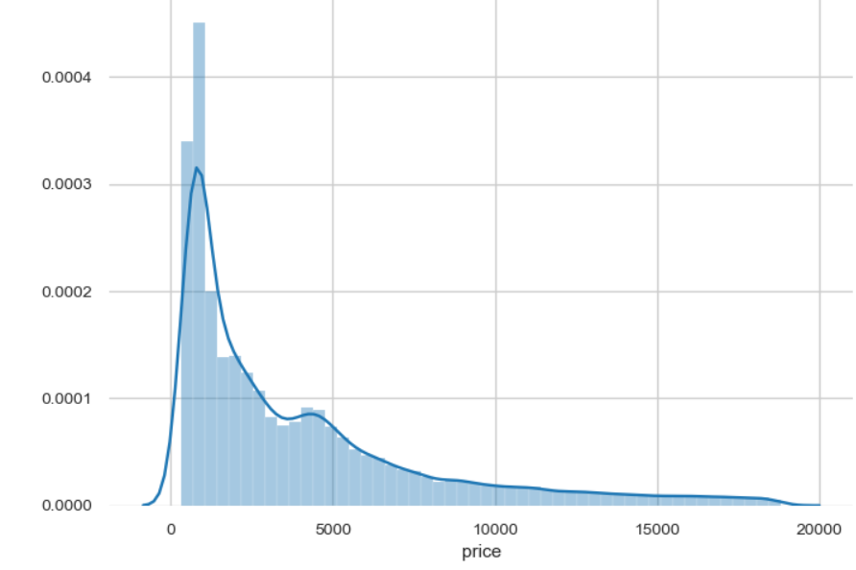
Price being the target value, let’s see how it is distributed
This shows that the price range of diamonds lies mainly between 326 USD to 5000 USD

Slide 8
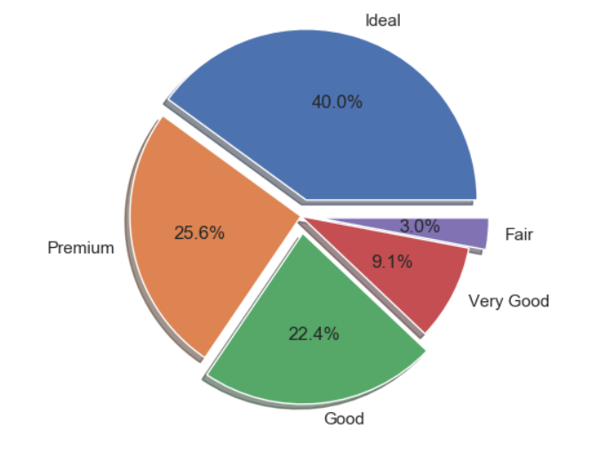
Cut of a diamond vs price.
As we can see that cut with higher quality are produced more than the lower quality cut and the production rate decreases from ideal to fair, showing that higher cut diamonds are more in demand

Slide 9
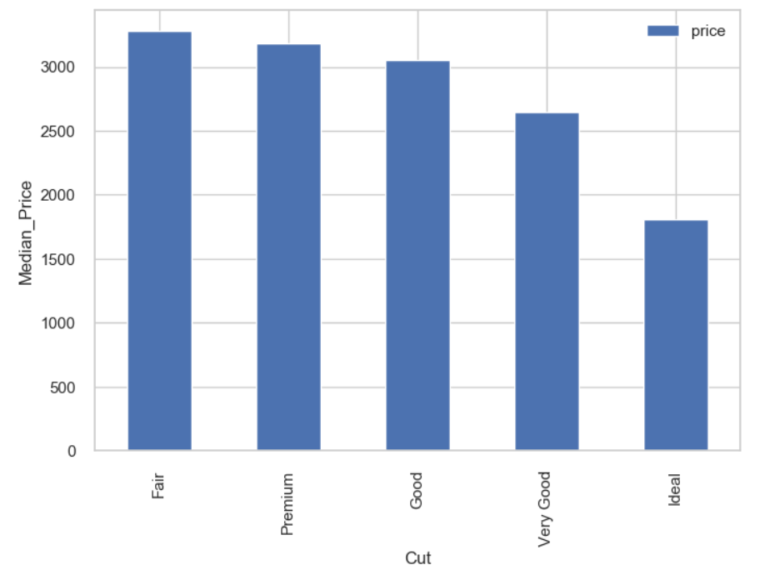
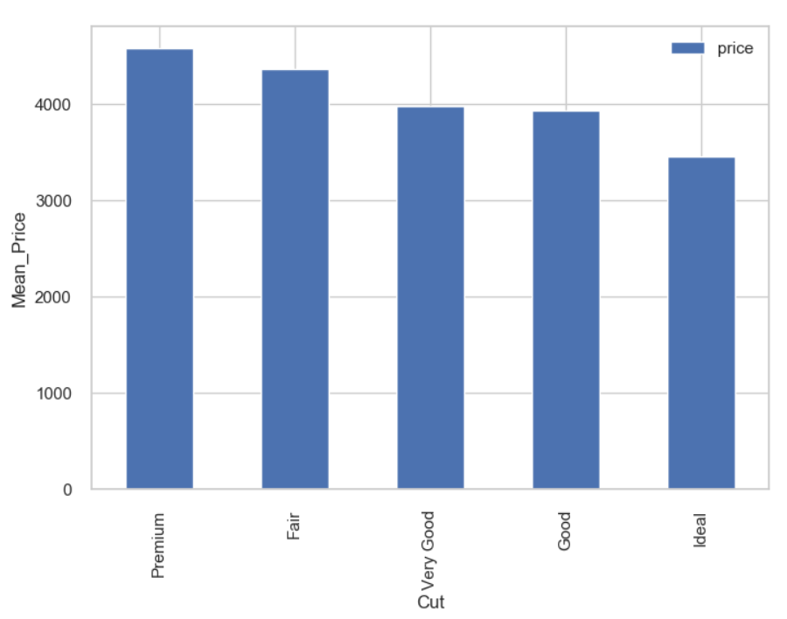
Looking at mean and median prices of various cuts
All the cuts have very comparable average price and ideal cut has the lowest median value so this contradicts a very common assumption that, better the quality of cut higher the price but instead the opposite is true and that could be the reason why they are high in production rate and may be their supply is more than their demand
Interestingly enough the fair cut which is of the lowest quality is among the highest average and median price along with premium cut. Fair cut being lowest in production and having highest price shows that it has very limited supply but demand is high or as we will see later that fair cut diamonds belong to high carat diamonds.
Premium cut along with second highest production has the highest average price and second highest median price. This shows that premium cut even though is expensive its production rate has not been decreased. So it is a clear sign that as its prices have not been dropped so its demand is still there.

Slide 10
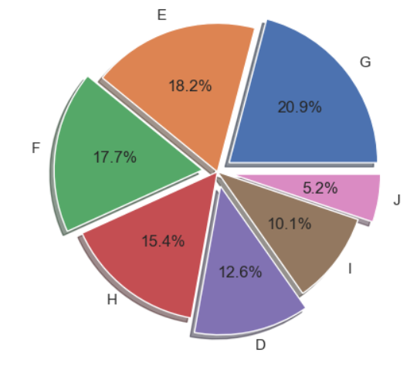
Color of a diamond vs price
G is of average quality color. And the diamonds of average quality color are produced the most followed by the second best color quality E followed by the third best F.
Color of the highest quality D is produced very low in number followed by cheap color qualities, i and j.

Slide 11
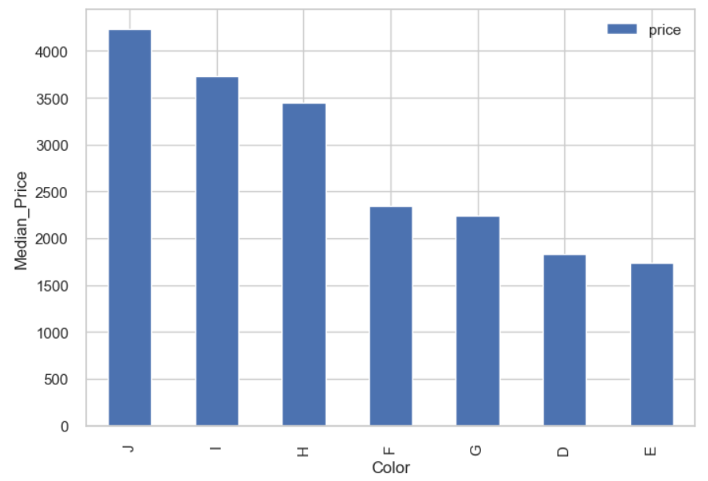
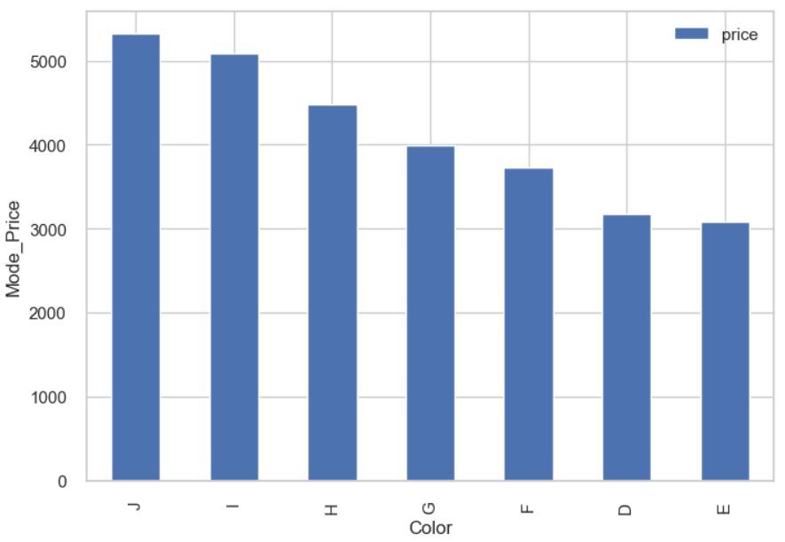
Looking at mean and median prices of various color
A very strange thing noticed here is that the colors of lowest quality(H,I,J) are priced the highest. Will have to check the carat values of each of these may be that is effecting the pricing.
And the colorless diamond D is among the least expensive accompanied by second best E and third best F.

Slide 12
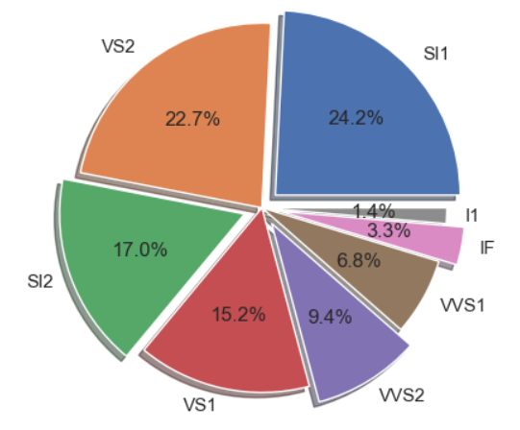
Clarity of a diamond vs price.
Diamonds of lowest clarity as well as highest clarity are produced lower in number. Possible reasons could be that clearest diamonds are difficult to create and thus are expensive and therefore lower in demand. Lowest clarity diamond on the other hand will not be preferred by customers as it will have defects visible to the naked eye and thus less appealing to the customers.
Diamonds with clarity 'SI1', 'SI2', 'VS1' and 'VS2'are produced the most showing that they are high in demand

Slide 13
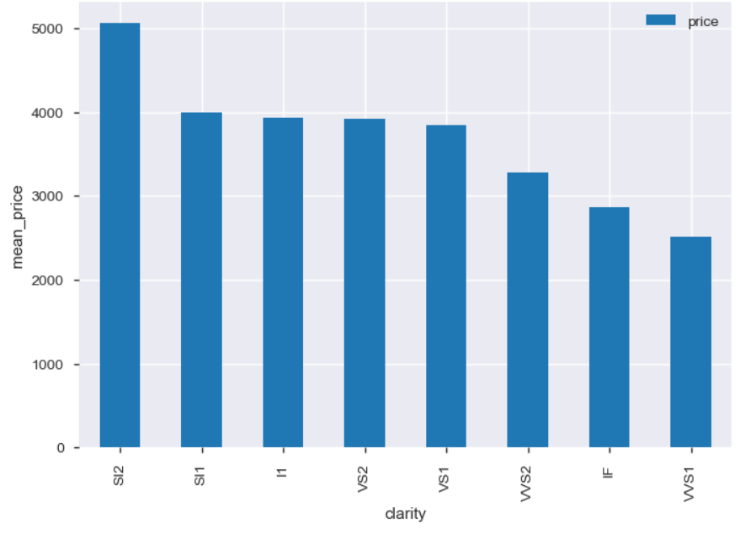
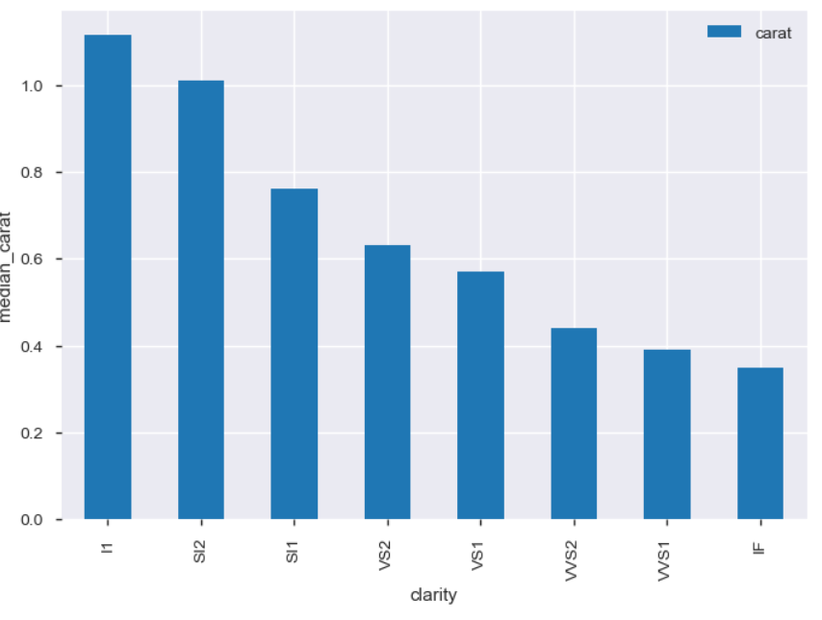
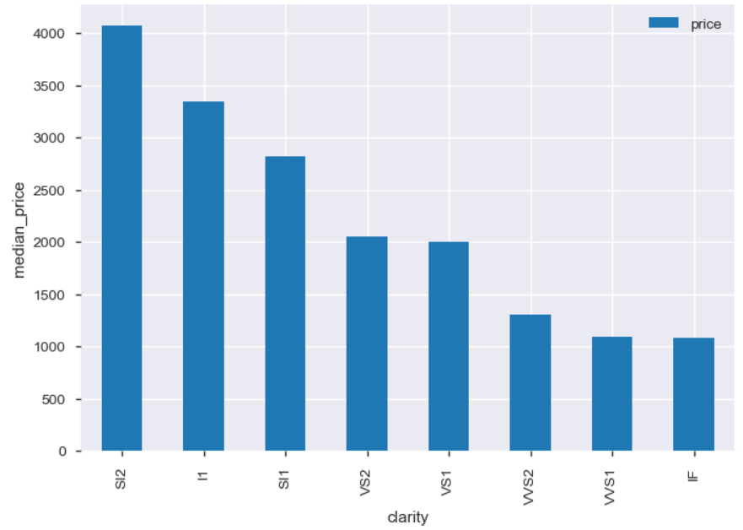
Looking at mean and median prices of various clarity
'SI1' , 'SI2' and 'I1' are among the expensive diamonds.
'I1' is the lowest clarity diamond but is among the most expensive diamonds, they are those diamonds which are high in carat value and have no human modifications to them.
With increase in clarity there is decrease in carat value which is obvious because to make clearer diamonds we have to reshape them using various techniques and hence their carat value decreases.
The pricing is basically effected by carat value plus the demand.

Slide 14
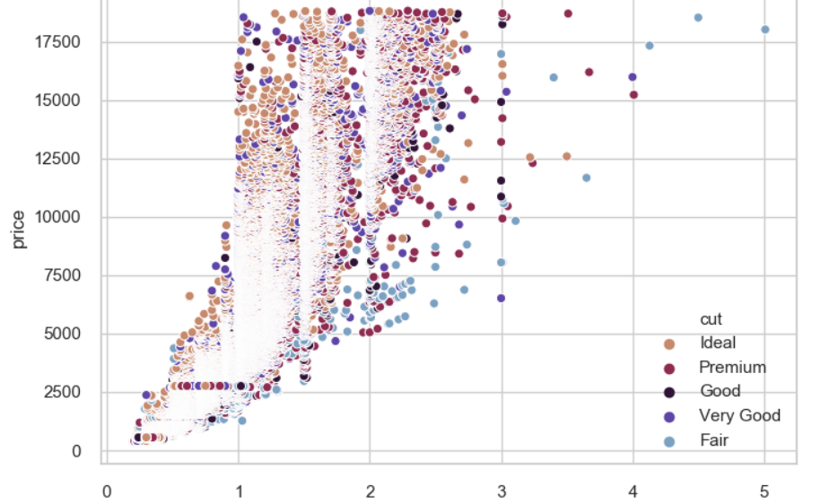
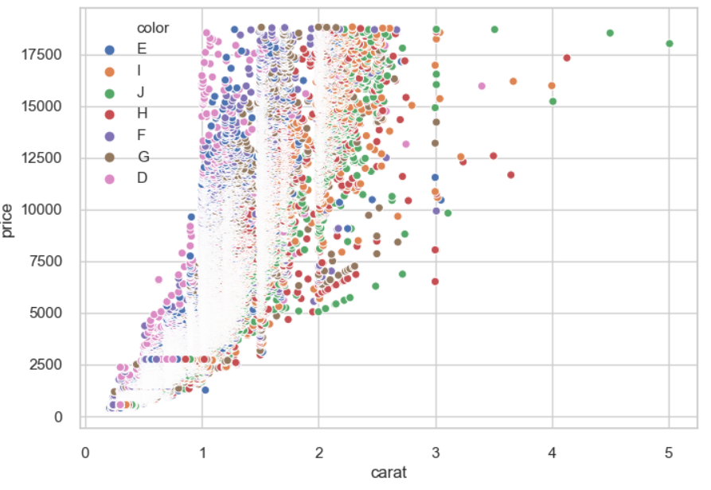
Effects of carat on price of various cuts, color and clarity.

Slide 15
Effects of carat on price of various cuts.
Diamonds with highest and second highest carat is having the lowest quality color and are among the most expensive diamonds. And they are among the rarest kind or we can say that they are big expensive rocks with little to no human modifications.
Diamonds with carat value greater than 2.5 are less in number and gets lesser and lesser as the carat increases. Along with a increase in pricing, where the color quality is not playing much of a role in determining the price.
Most of the data points lie between the range from 1 to 2 so let's zoom in on that part.

